Slide 1
Medical Image Morphological
l'•t .TECH All‘•t L • COI‘•t PUTER VISION Uni-t I Mathematical Morphology
Processing Using Brain MRI
Non -learning OpenCV pipeline for st ructural segment at ion. binarizat ion. and
boundary extraction.
Dataset Source
y › Core Stack

Slide 2
Mathematical Morphologg Objectives
PROJ ECT SC OPE
Light Normalization
Standardized 256x256 grayscale matrix.
Otsu Binarization
Automated tissue—background segmentation.
Set Morphology
Erosion, Dilation, Opening, Closing.
Boundary Search
Internal contour via set difference.

Slide 3
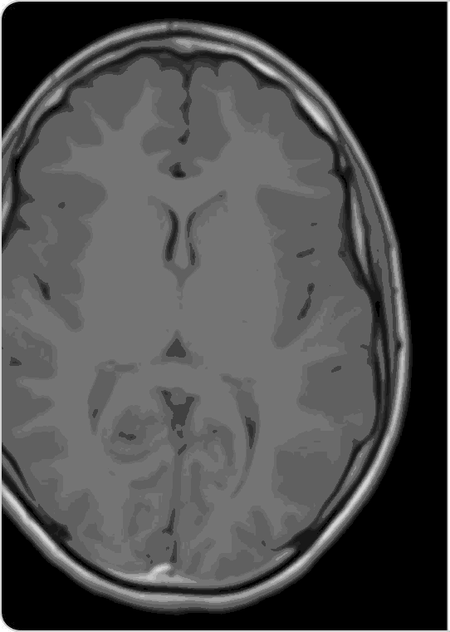
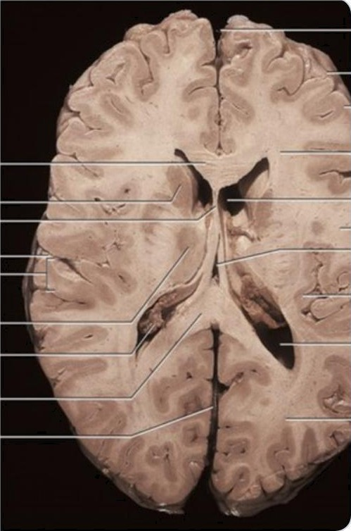
Brain MRI Acquisition & Normalization
STEP O1 PI PELINE
Automated Multi-Path Loader: Searches local repository and
mounted Google Drive dynamically.
Single-Channel Conversion: Loads scan directly into 8—bit grayscale space (”cv2.IMREAD_GRAYSCALE”).
Spatial Resampling: Standardizes input to 256x256 matrix resolution.
Deterministic Pipeline: Eliminates machine learning training dependencies.
Output Dimension: 256 x 25ó Pixel Matrix

Slide 4
STEP 02 PIPELINE
lntensitg Distribution & Contrast Metrics
MEAN INTENSITY (p)
119.79
Average plobal brightness
STD DEVIATION (o)
49.75
Inte nsity variance & contrast
DYNAMIC RANGE
[12, 255]
*ull 8—bit scale utilization
Bi- Nodal Intensity Profile (Background vs Tissue)
0 (Dark Air Void)
Ootlmal C utoff T* = 95
255 (Bripht Brain Tissue)

Slide 5

Otsu Automatic Binarization
STEP 03 PIPELINE
Non-Parametric Segmentation
No manual intensity tuning required.
0 PTINAL THRE SH0
LD (T* )
Binary Matrix Generation
Converts image to boolean (0, 255} state.
Calculated via intra—class variance minimization.
Tissue Separation
Isolates brain parenchyma from background air.

Slide 6
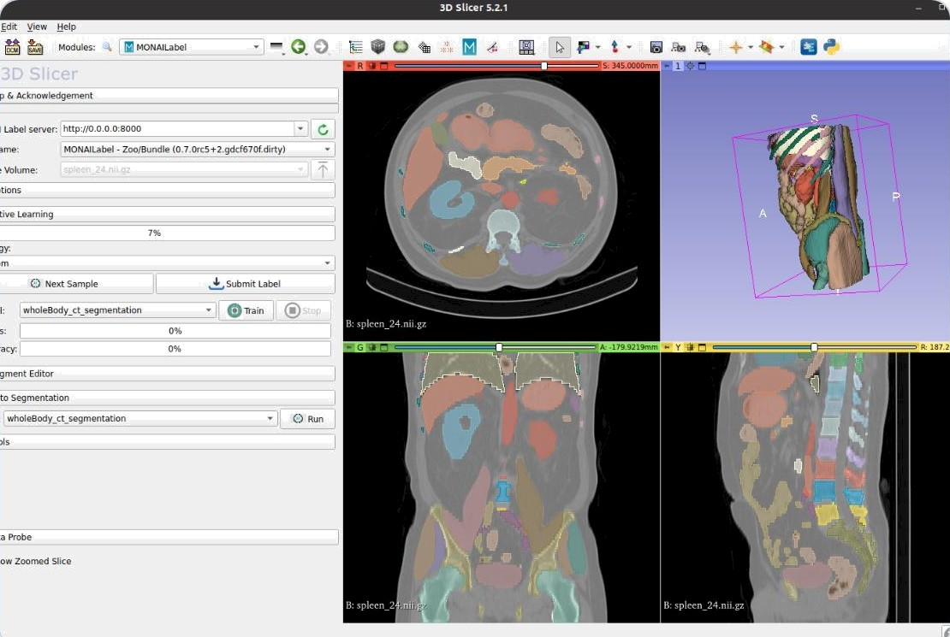
Morphological Boundarg Extraction
STEP 0 5 PIPELINE
MATHEMATICAL FORMULA
§(A) = A - (A • B)
Set Difference: Subtracts eroded mask from original binary mask.
Single-Pixel Contour: Produces exact l —pixel structural outline.
Red Channel Overlay: Superimposes boundary onto grayscale scan.

Slide 7
Structuring Element Scale Impact
STEP 0 6 PIPELINE
3 x 3 Kernel
5 x 5 Kernel
7 x 7 Kernel
Mild Thinning
Preserves fine anatomical details.
Moderate Shrinking
Smoothes structural outer edges.
Severe Loss
Erodes critical thin structures.

Slide 8
Master Pipeline Execution Flow
STEP 07 PIPELINE
Input & Normalization
Graysc ale read and 256 x 256 matrix resize.
Otsu Thresholding
Auto-b imodal cutoN calculation (T* = 95).
Morphological Filter Suite
Ap ply Erosion. Dilation. Opening. and Closing.
Boundary & Overlay Rendering
Extract contour diNerenc e and render red overlay.

Slide 9
Clinical & Computational Takeawags
IM PACT
Ultra-Fast Execution
Sub—millisecond processing per frame.
Pre-Segmentation Utility
Ideal preprocessing for deep learning.
Deterministic Precision
Zero training dataset requirements.

